Slide 2
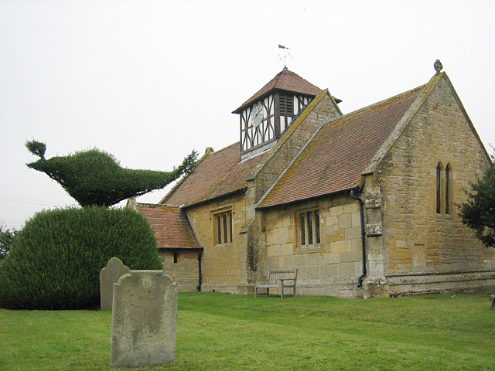
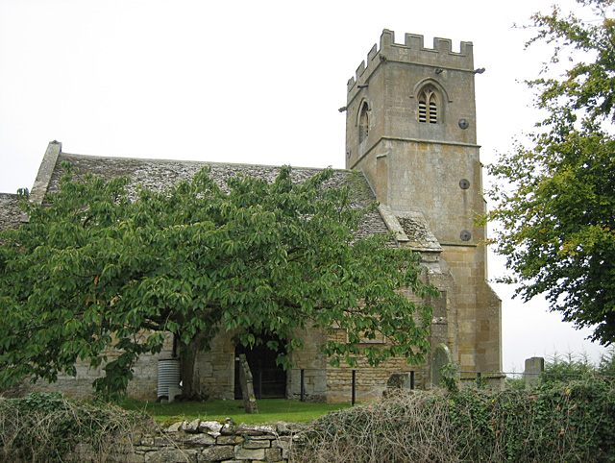
The Way Forward
Supporting
St Margaret’s Alstone and
St Nicholas’ Teddington

Slide 3


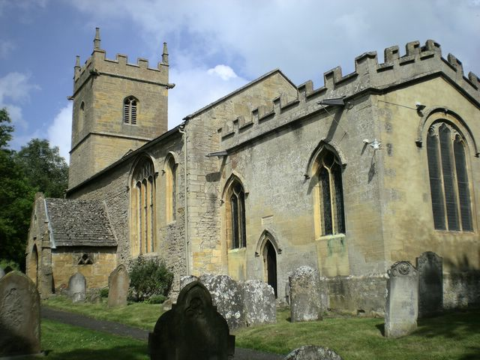
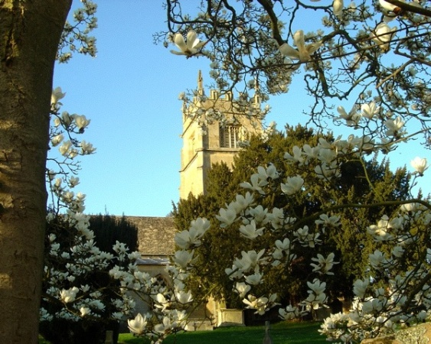
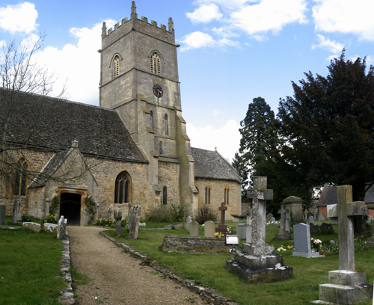
St Margaret’s and St Nicholas’ are part of the Beckford Group Parish,
now in the
Bredon Hill Group of churches,
in the Diocese of Worcester
St Barbara
Ashton under Hill
St Faith
Overbury
St John the Baptist Beckford

Slide 4
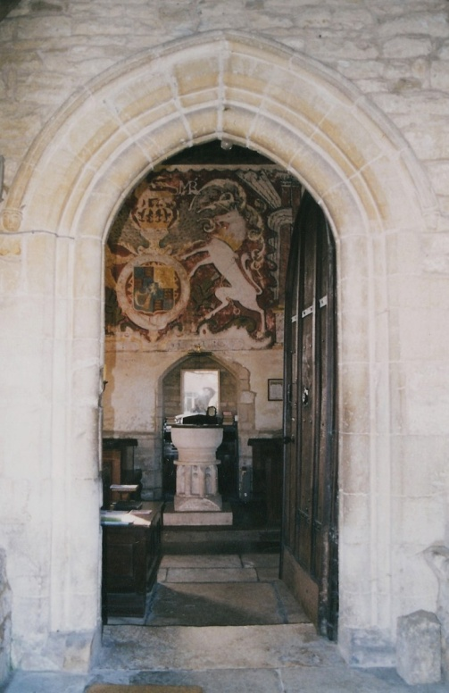
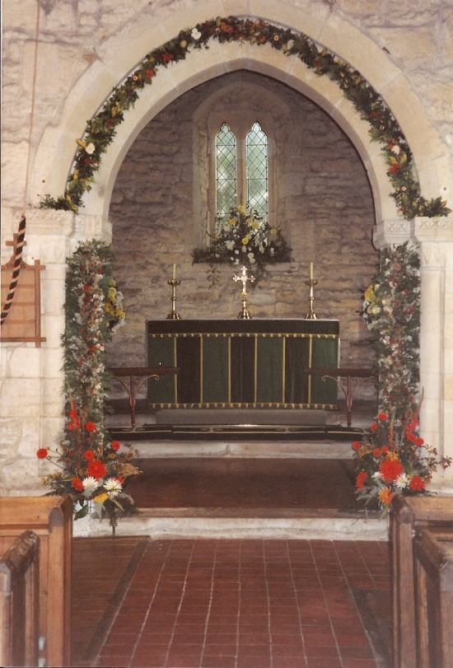
Each of our churches is very different and they have all been lovingly cared for over the centuries
They are beautiful listed buildings that are time-consuming and expensive to maintain. There is no financial support from the Government or the Church of England

Slide 5
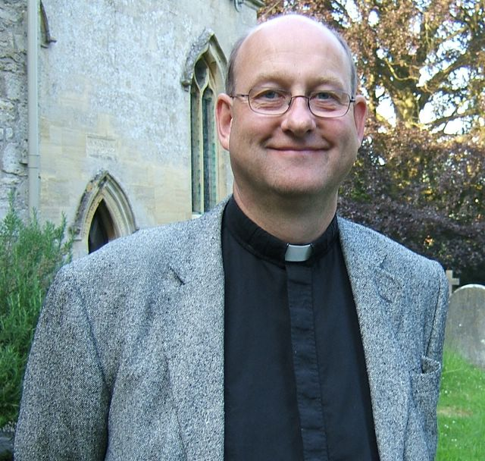
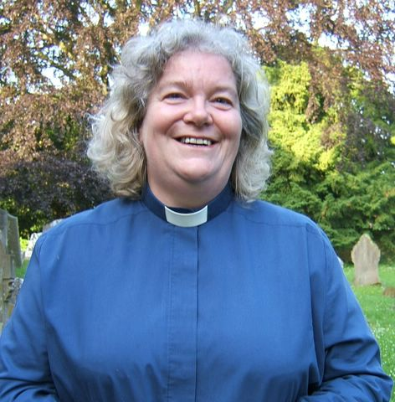
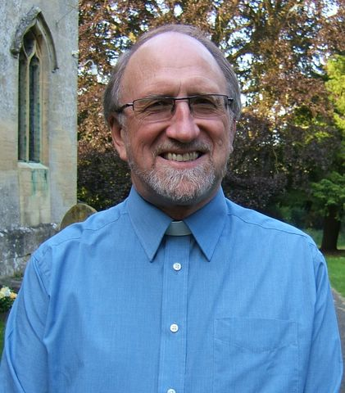
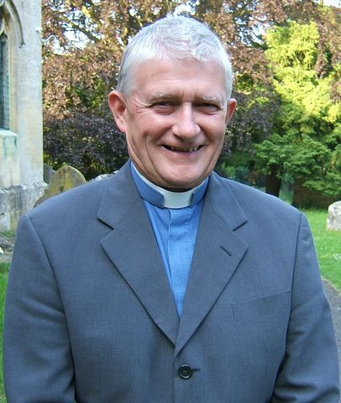
Ministry in our parish is currently led by
Rev Matthew Baynes
assisted by
Rev Susan Renshaw
who has pastoral responsibility for Alstone and Teddington,
Rev Terry Henderson
and Rev Clive Parr
They are shortly to be joined by our new curate Christine Turpin

Slide 6
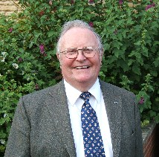
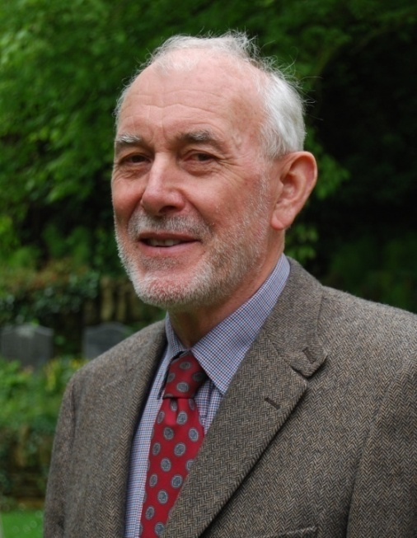
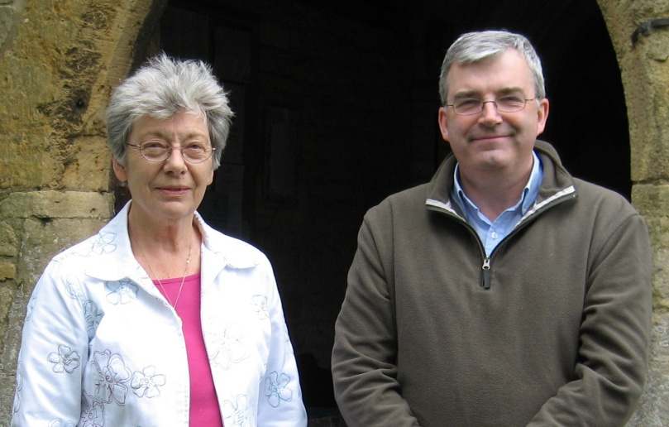
We also have the invaluable services of our Lay Readers:
Kalantha Brewis,
John Dodge, Dennis Oxley
and Roger Palmer
The churchwardens, together with the church committee, are responsible for the management and upkeep of the church. They are all volunteers

Slide 7
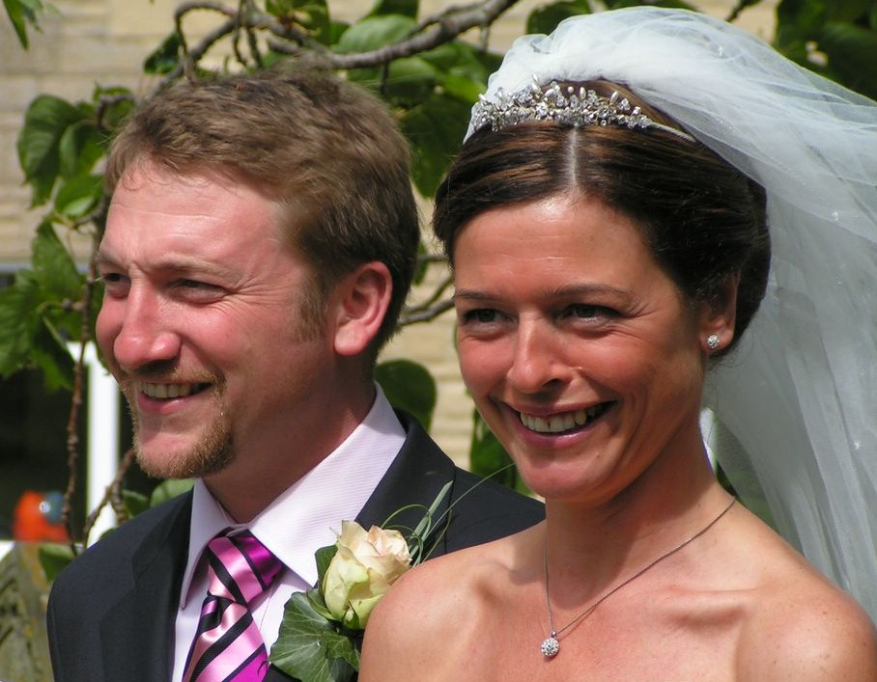
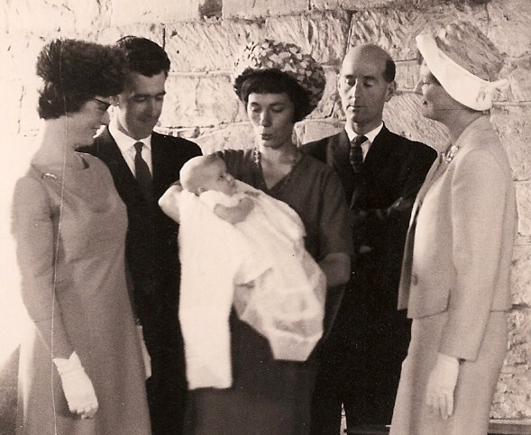
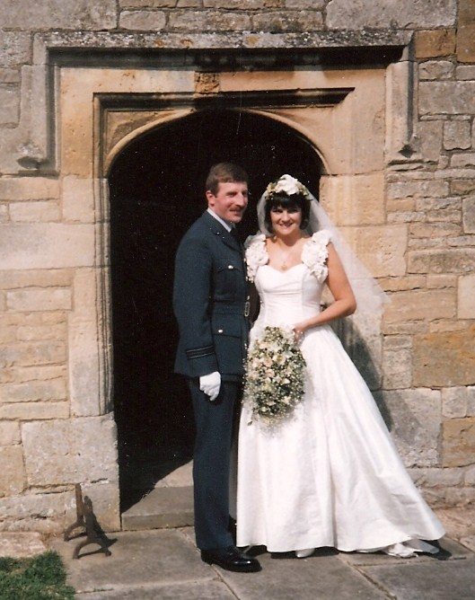
Our churches have been serving the community for over 900 years
and not just for baptisms,
marriages and funerals…

Slide 8
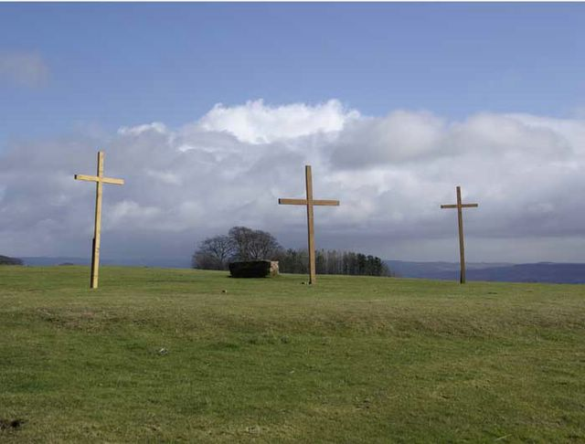
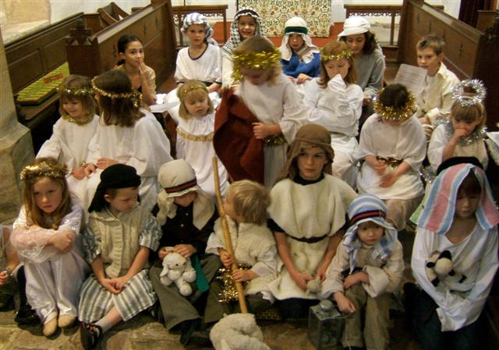
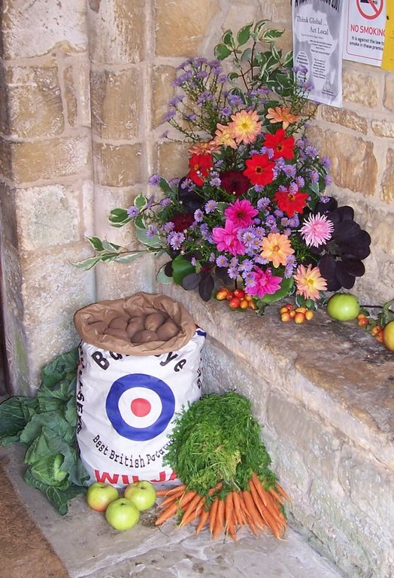
Our churches are here for the important festivals of Easter, Harvest and Christmas, as a focus for family life

Slide 9
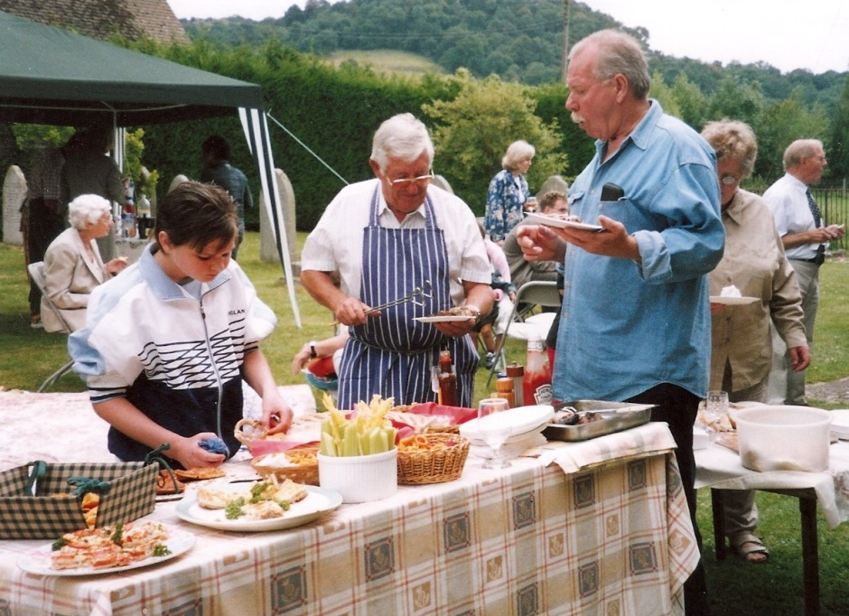
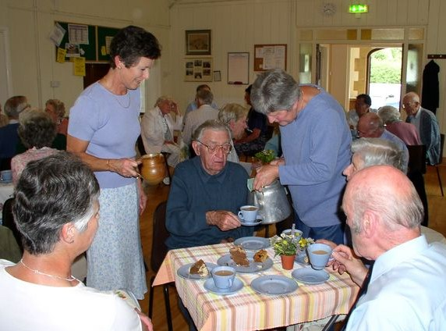
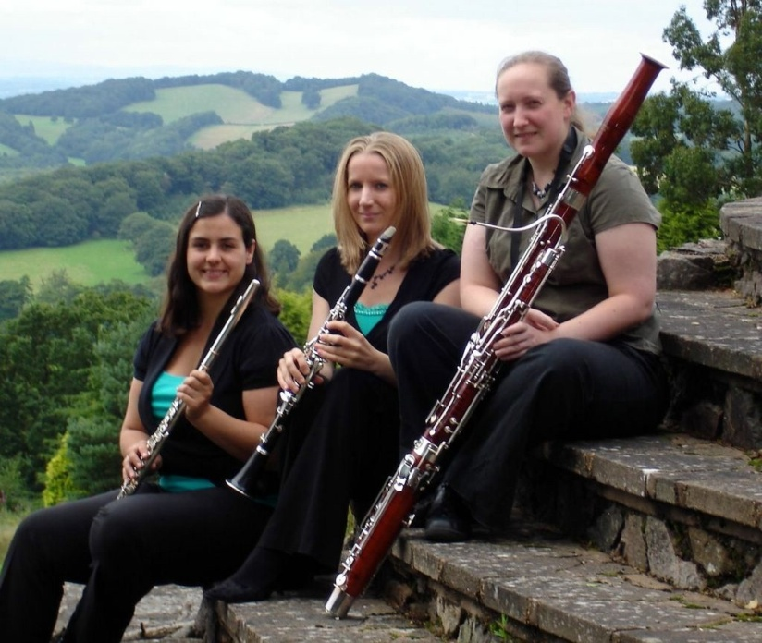
Our churches
take a lead in community activities

Slide 10
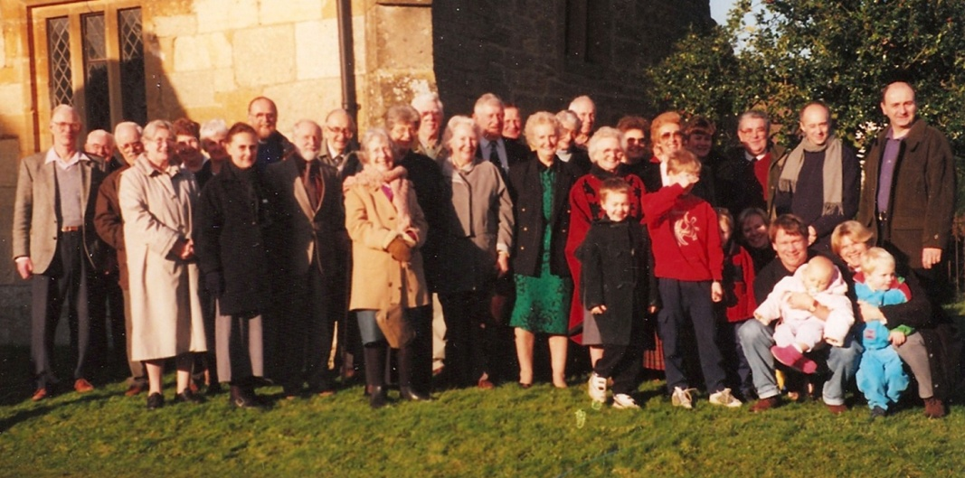
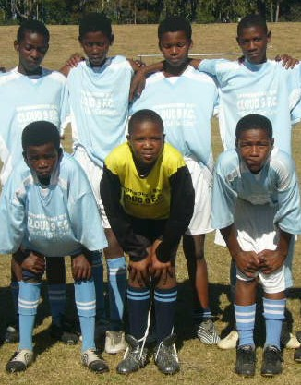
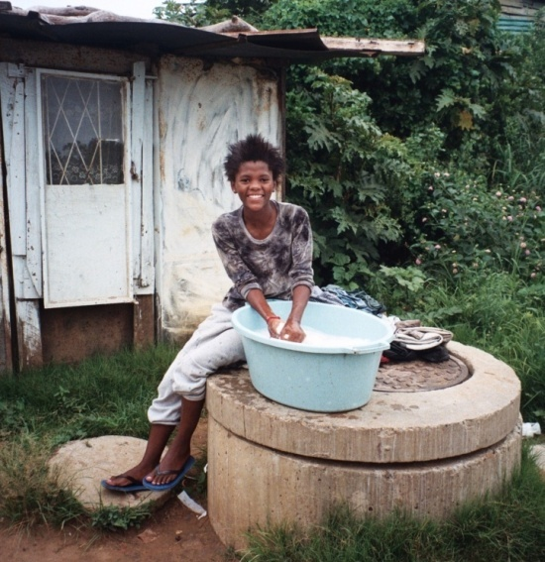
…and play an active part in fund-raising for the benefit of local people
We also support international charities, one of which helps vulnerable children and adults in
South Africa

Slide 11
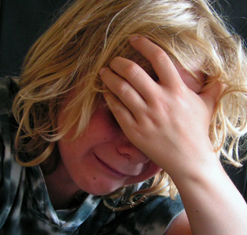
The clergy and lay members of the church provide pastoral care at time of bereavement, illness or other difficulty

Slide 12

The Church will always support you…
…and the Church will always need your support

Slide 13
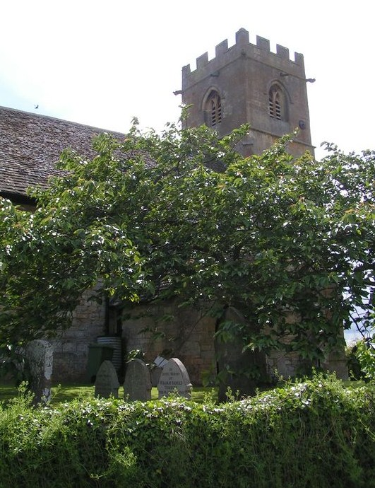
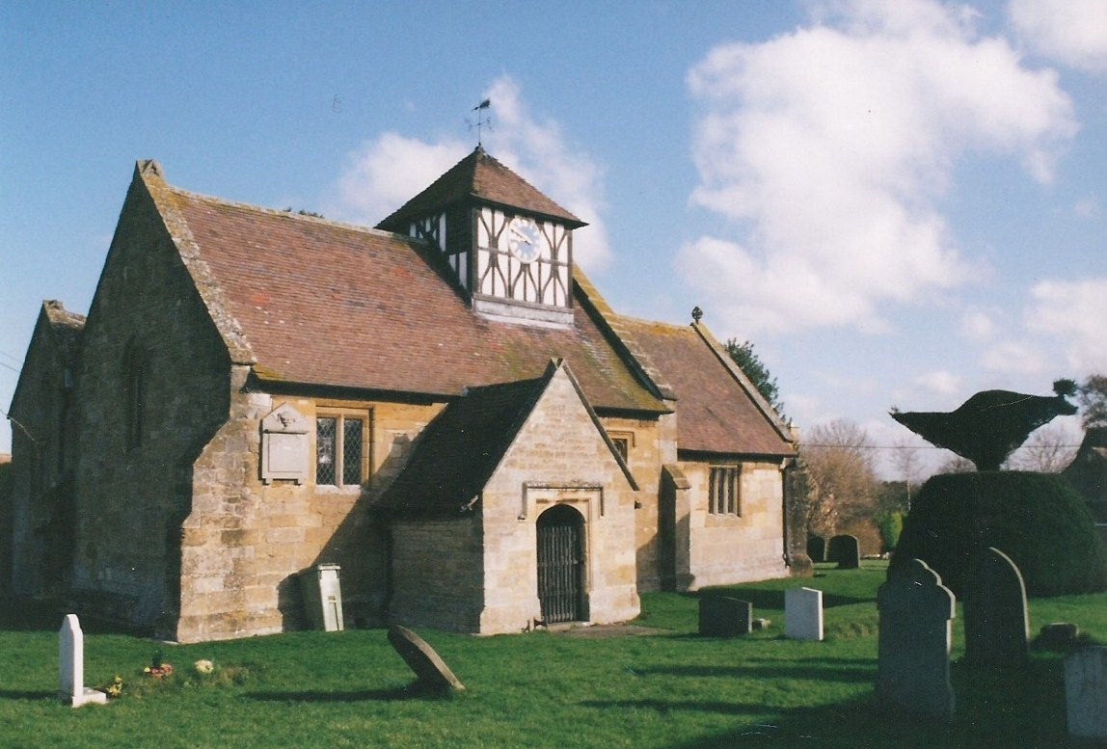
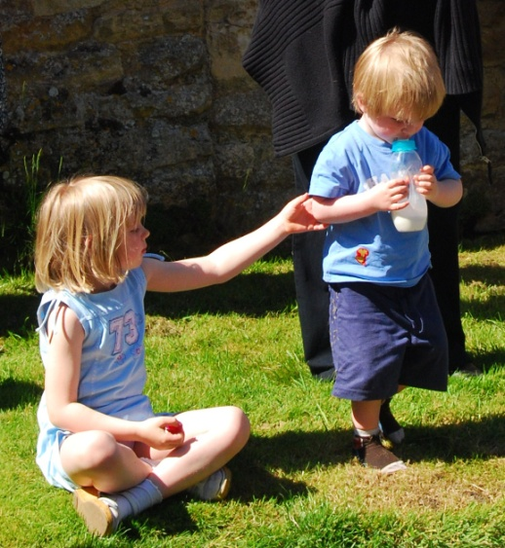
Our churches belongs to all of us,
not the Church of England,
the Government or anyone else.
It is our responsibility to maintain them for future generations

Slide 14
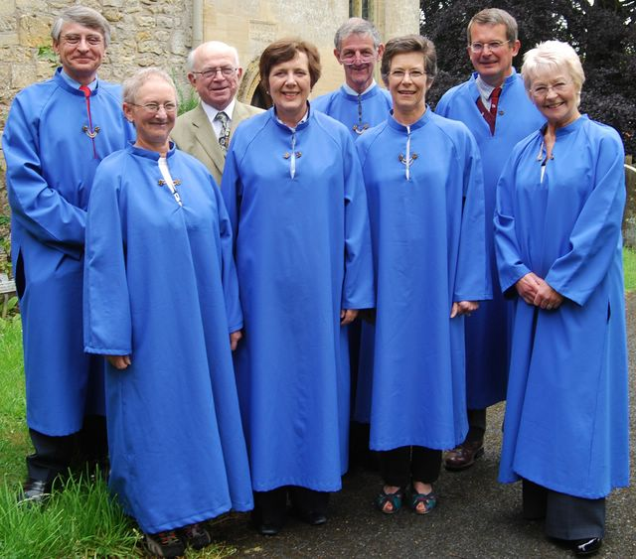
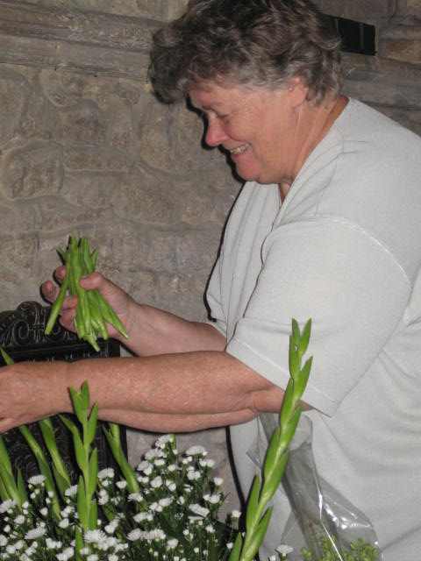
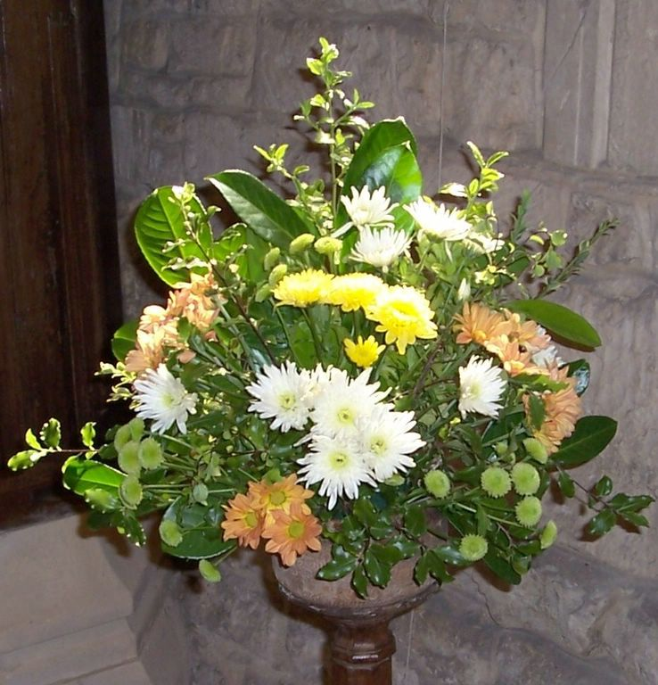
Delivering magazines
Arranging flower displays
Playing the organ
Church cleaning
Locking and unlocking
Fundraising
Providing refreshments
Organising events
Tidying the churchyard…
Many people contribute their time and skills to the life of
our parish

Slide 15
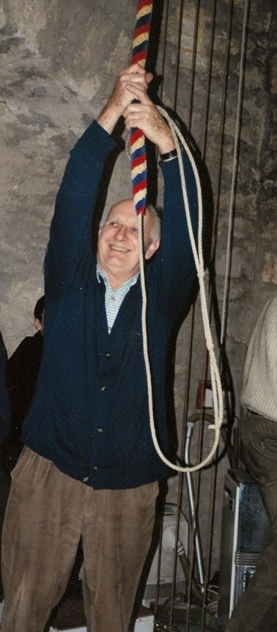
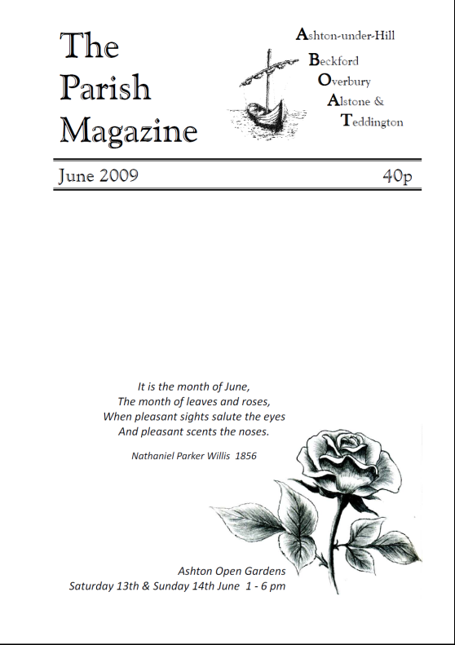
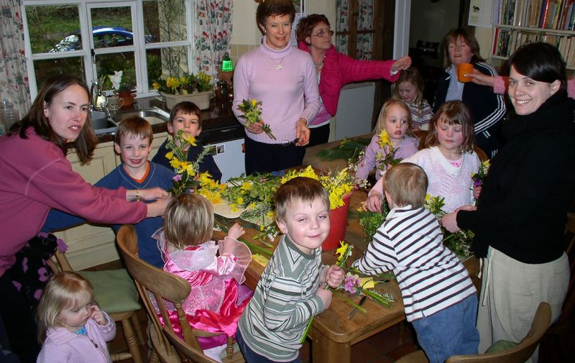
…Ringing bells
Editing the magazine
Compiling Pew Notes
Printing and copying
Looking after the finances
Running children’s activities
Organising special services
Welcoming the congregation
….and much, much more

Slide 16
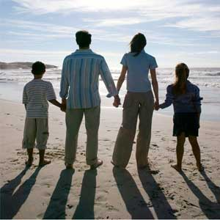

We are one family, and like any family, we need to plan for the future…
We urgently need your help to maintain our churches at the heart of our community

Slide 17
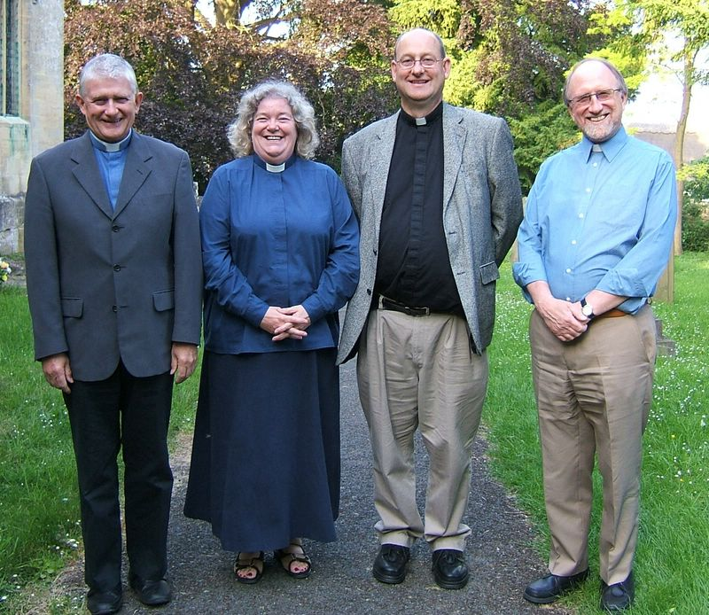
Every year we undertake to make a financial contribution
to the Diocese of Worcester
to help pay for our clergy.
This is our ‘Parish Share’
In 2008 the Parish Share for the Beckford Group was £52,800, but the parish was £7,500 short in meeting this commitment

Slide 18
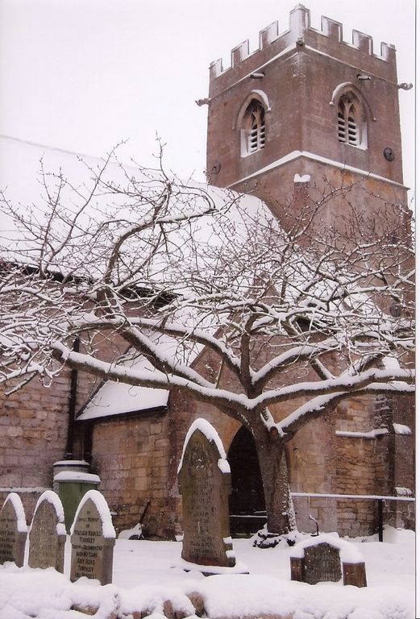
In 2009 we are facing a similar shortfall in our accounts and so we will be unable to pay what is needed
This is a situation repeated throughout the country. It is one of the reasons why there are decreasing numbers of clergy

Slide 19
Our finances in 2008
What we received
How we spent it

Slide 20
Please make a financial gift to the church by regular planned giving. If you are a taxpayer we can currently reclaim 28p in every pound if you complete a Gift Aid declaration
How can you help?
If you already give regularly, please would you consider increasing your gift?
Whatever you can afford is valued and appreciated. Your contribution, large or small, will help to support the Church’s ongoing ministry in our community

Slide 21
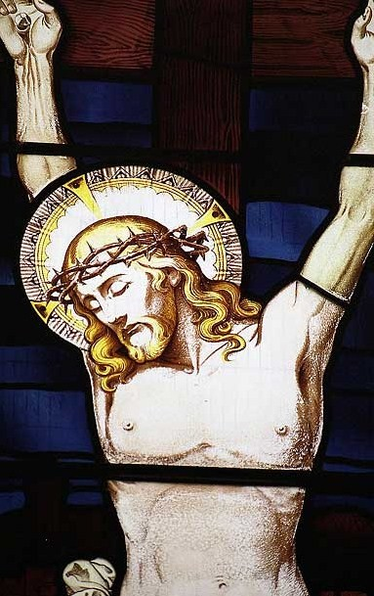
If you have any questions about helping the churches in Alstone and Teddington, or would like to pledge your support, please contact:
Rev Susan Renshaw
01386 750203
or Anne Kyle 01242 620351
Kieran Whelan 01242 620763
churchwardens

Slide 22

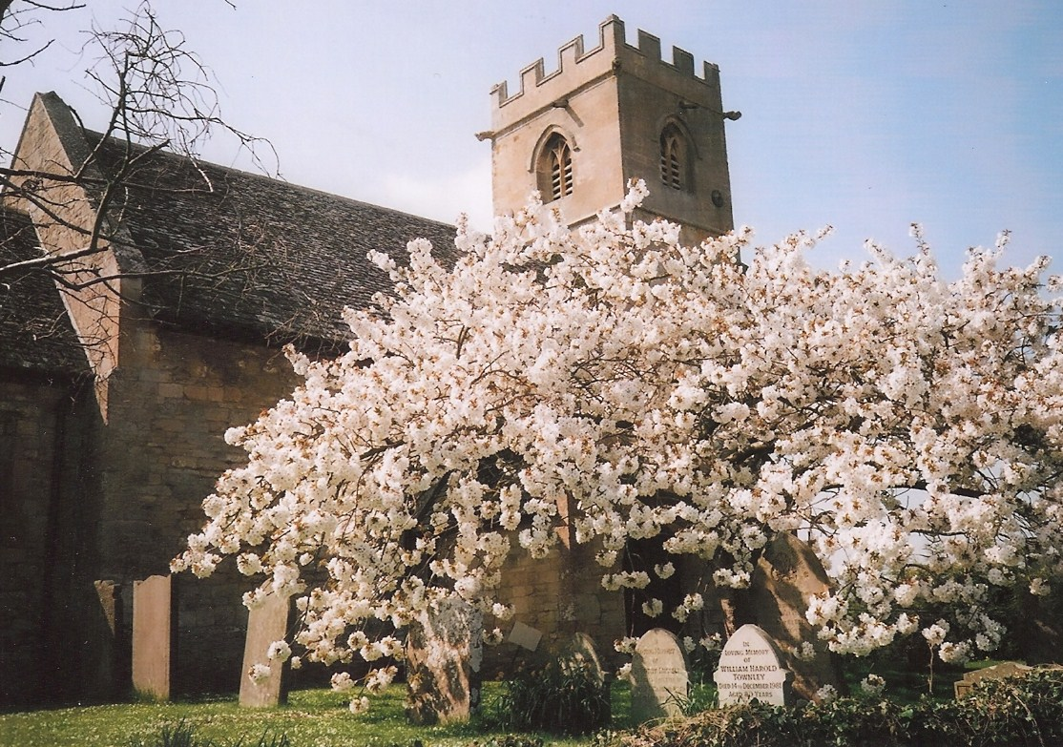
Thank you

